Slide 1
Czar Ian Echavez
BSc Computer Science
Supervised by
Atta Badii
And
Tom Thorne

Slide 2
Panel Introduction
Prof. Atta Badii
Prof. Xia Hong
Dr. Pat Parslow
Dr. Hong Wei

Slide 3
Outline
Problem statement
Case Studies
Mathematical model of zombie spread
Solution Implementation
Evaluation of solution
Possible improvements
Notes:
This is the general structure of this presentation. I will first go through the

Slide 4
Problem statement
There are a wide variety of existing simulators that deal with how epidemics spread around the world.
Some of there are too simplistic or do not offer enough customisations for their users.
Are built specifically for one type of disease i.e. viruses
Do not simulate other scenarios (in this case, zombies)

Slide 5
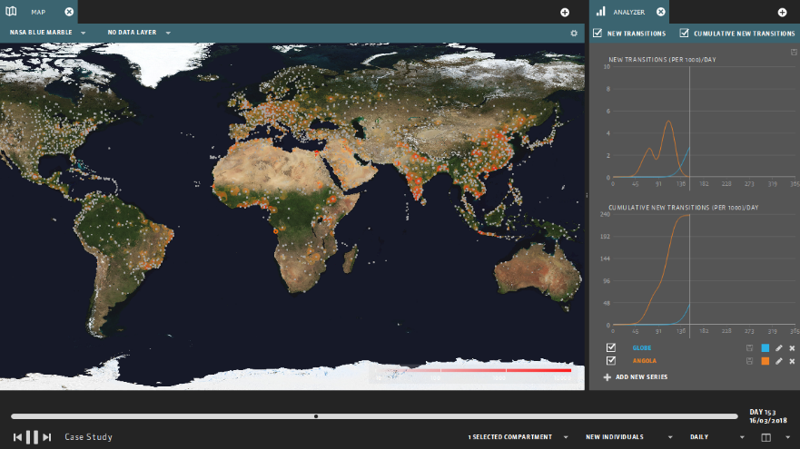
Case Study 1 - GLEAMViz
Limitations
Simulations are not run client side i.e. requires internet connection to run simulations
Intense calculations, utilises GLEAM servers
Too complicated to use

Slide 6
Case Study 1 - GLEAMViz
Advantages
Accurate simulations
Plots graphs to show how disease progresses throughout simulation
Uses real world data

Slide 7
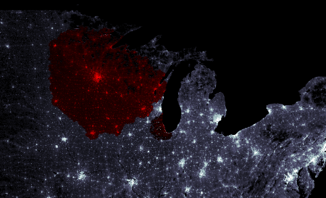
Case Study 2 – ZombieTown USA
Limitations
Not very accurate
Does not accurately show different ways disease spreads (only shows spread via ground movement)
Only simulates on a map of the USA

Slide 8
Case Study 2 – ZombieTown USA
Advantages
Calculations are not too hardware intensive
Easy for new users to use
Also simulates spread of disease with zombies as infection vector

Slide 9
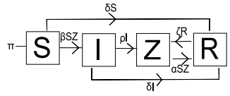
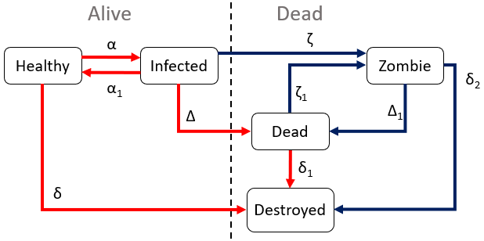
Mathematical Model
Multiple mathematical models exists on
how diseases spread however, not a lot
take into consideration spread of zombies.
The SIZR model taken from a journal modelling
a zombie outbreak was used as the basis of the
simulator, with some alterations
Taken from
https://mysite.science.uottawa.ca/rsmith43/Zombies.pdf
Altered model used in the ZEUS System

Slide 10
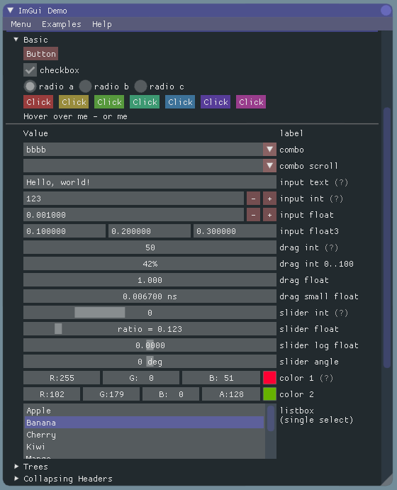
Implementation - GUI
GUI items handled by header library called ImGUI
GUI items allow for easy interaction between the simulator and the user

Slide 11
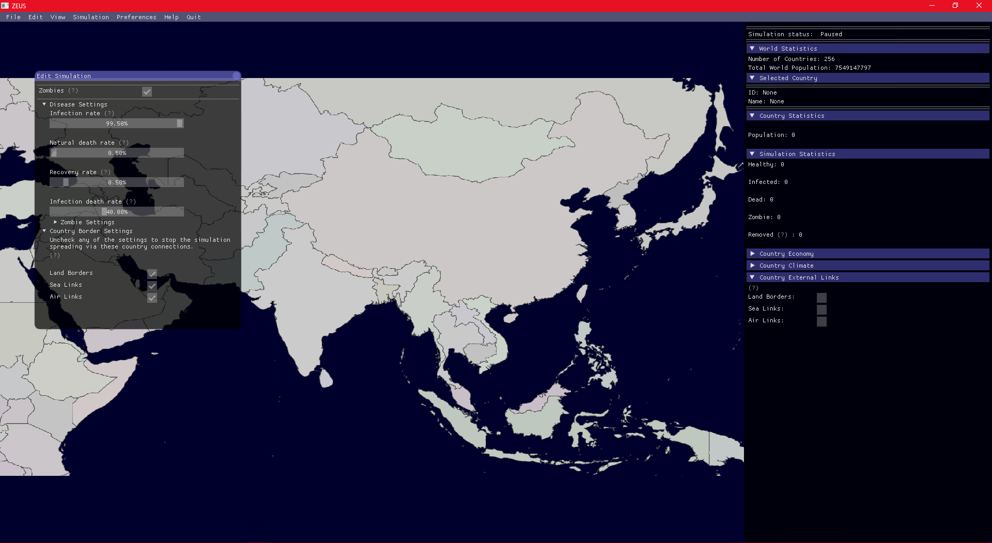
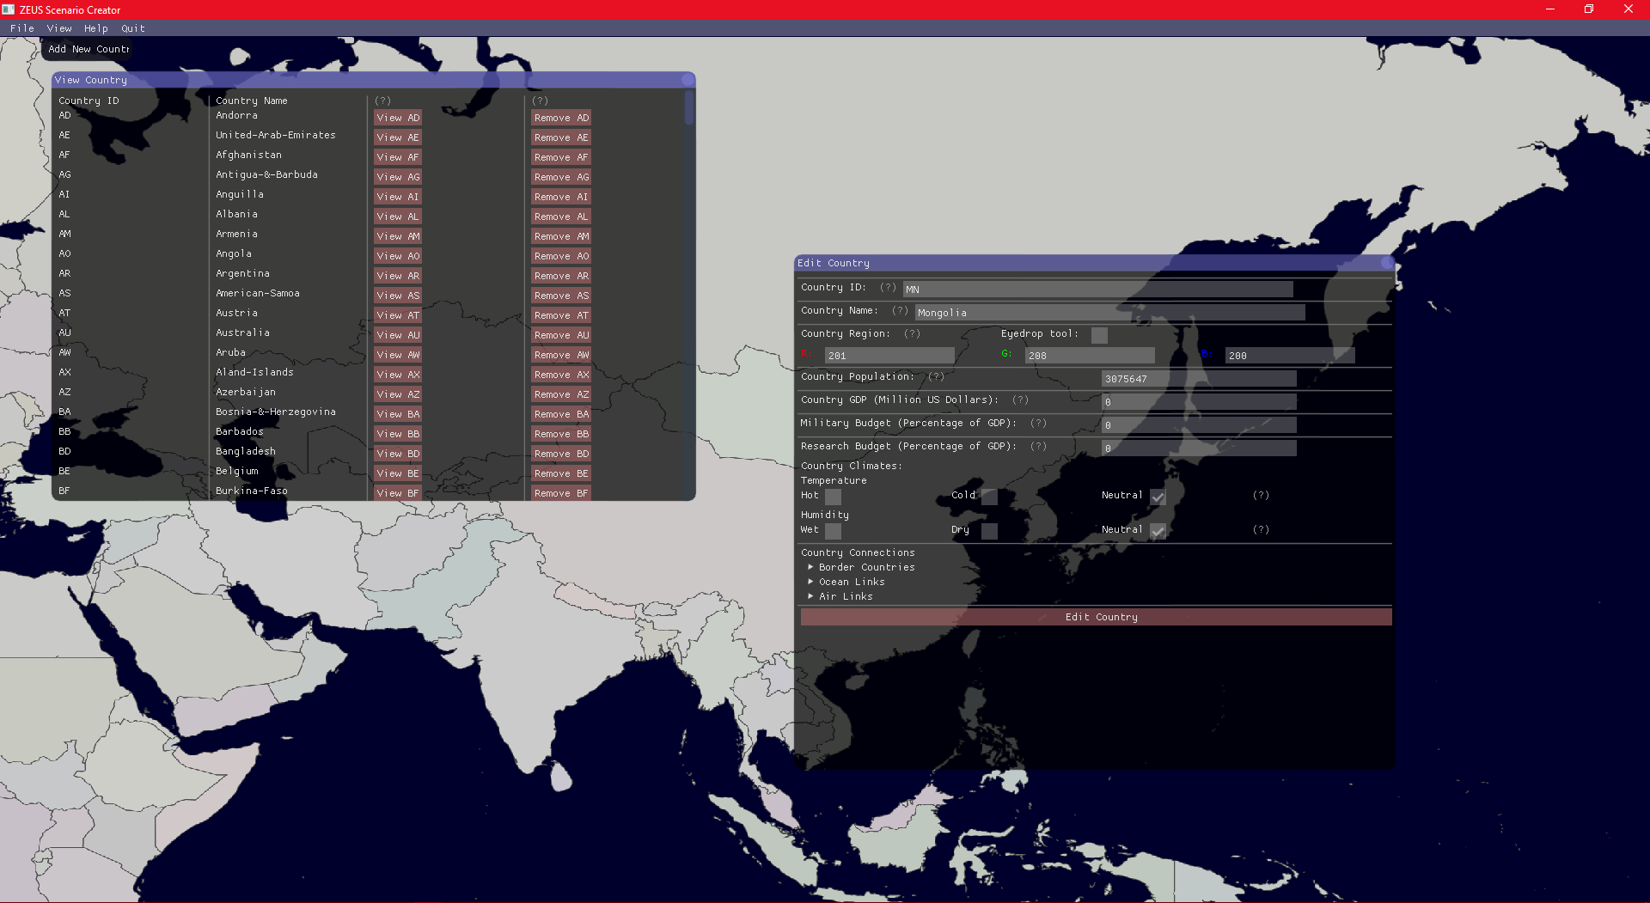
Implementation – ZEUS System
The ZEUS System is split into 2 pieces of software:
Main Simulator
Scenario Creator
Two pieces of software created for two different purposes. Simulator visualises the spread of disease while the scenario creator is for advanced users wanting to make new scenarios
Main Simulator
Scenario Creator

Slide 12
Scenario Creator
Used to create new maps (scenarios) that the simulator runs on.
Scenarios can also be coded via text, but scenario creator is useful for standardising the scenario files
Scenario Creator

Slide 13
Simulator
The main part of the ZEUS System
The software that runs the simulations.
Allows users to edit simulation values and then run simulations
Main Simulator

Slide 14
Evaluation
ZEUS System is not too complex and easy to use
Simulations are semi-realistic
Allows for more customisations by letting users create scenarios
2 software in the ZEUS System have different levels of complexity
Simulator is easy to use
Scenario Creator is a little more complex

Slide 15
Possible improvements
Some bugs need to be fixed
Improve the visualisation so the infected countries are a different colour
Show more data on the sidebar – does not show the values of all countries i.e. amount of people infected in the entire world

Slide 16
References
GLEAM Simulator [Online] [Accessed 26 March 2018 09:33]
http://www.gleamviz.org/simulator/
Zombietown USA Browser Demo [Online] [Accessed 26 March 2018 20:45]
http://mattbierbaum.github.io/zombies-usa/
WHEN ZOMBIES ATTACK!: MATHEMATICAL MODELLING OF AN OUTBREAK OF ZOMBIE INFECTION [Online] [Accessed 27 March 2018 02:26]
https://mysite.science.uottawa.ca/rsmith43/Zombies.pdf
CIA World Factbook Data – used for creating the ZEUS default scenario [Online] [Accessed 04 April 2018 01:12]
https://www.cia.gov/library/publications/the-world-factbook/
ImGui (dear imgui) GUI library used in the ZEUS System
https://github.com/ocornut/imgui
SDL Simple Direct-Media Layer graphics library
https://www.libsdl.org/

